Slide 1
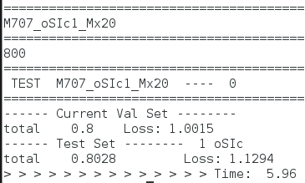
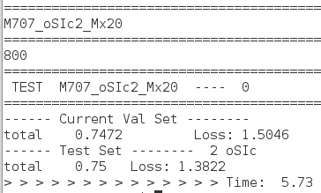
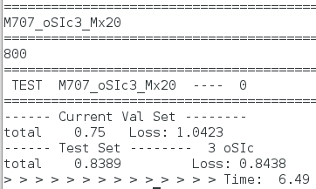
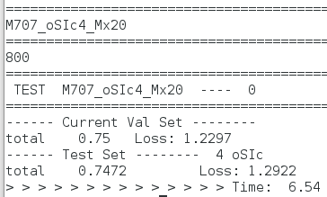
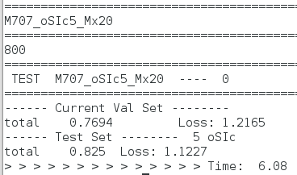
Single view - Model 707

Slide 2
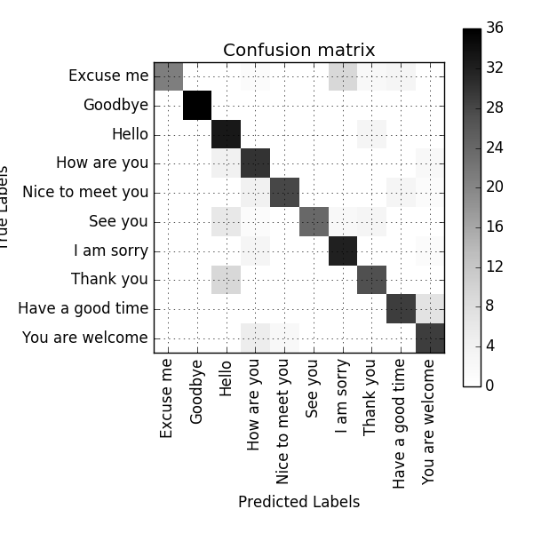
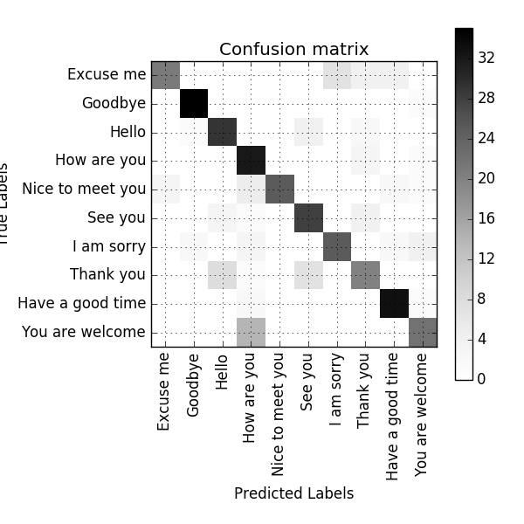
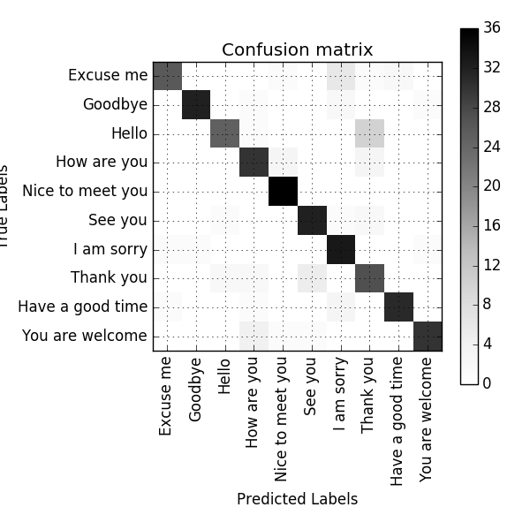
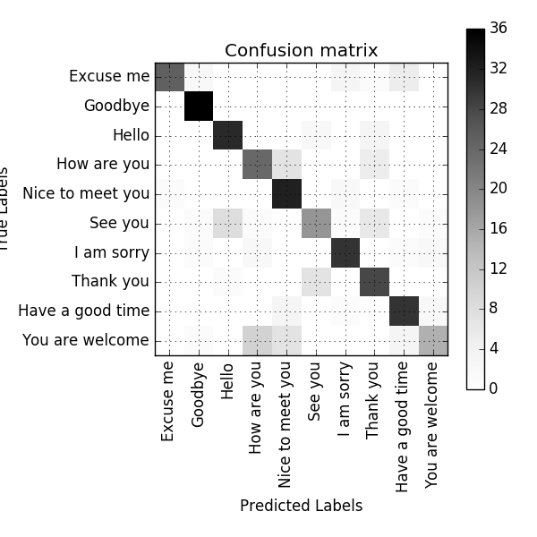
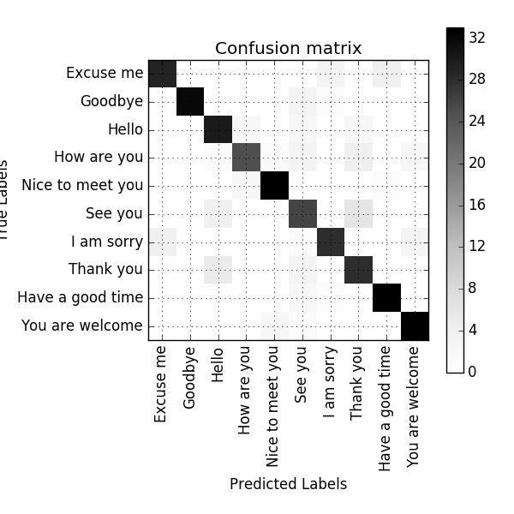
Single view - Model 707

Slide 3
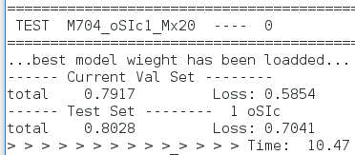
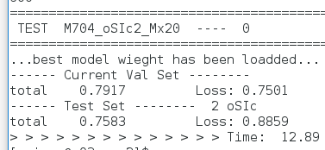
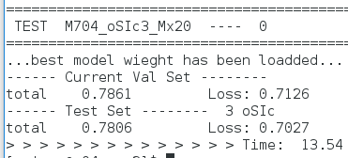
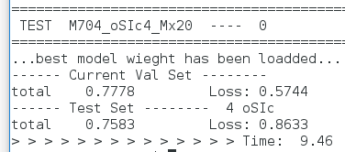
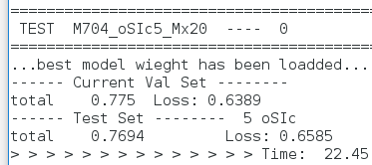
Single view - Model 704

Slide 4
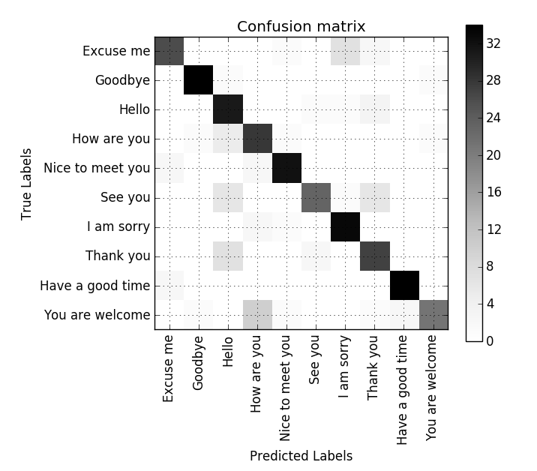
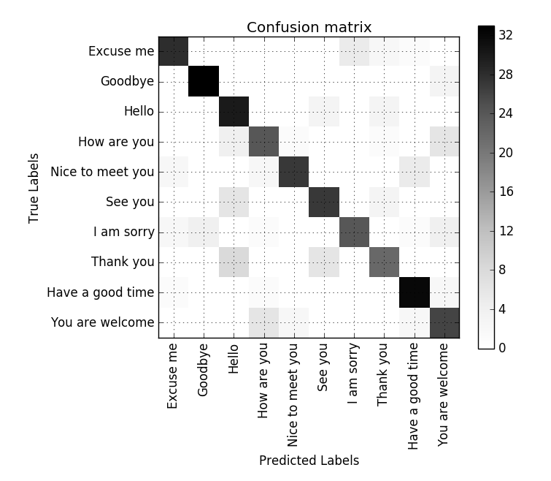
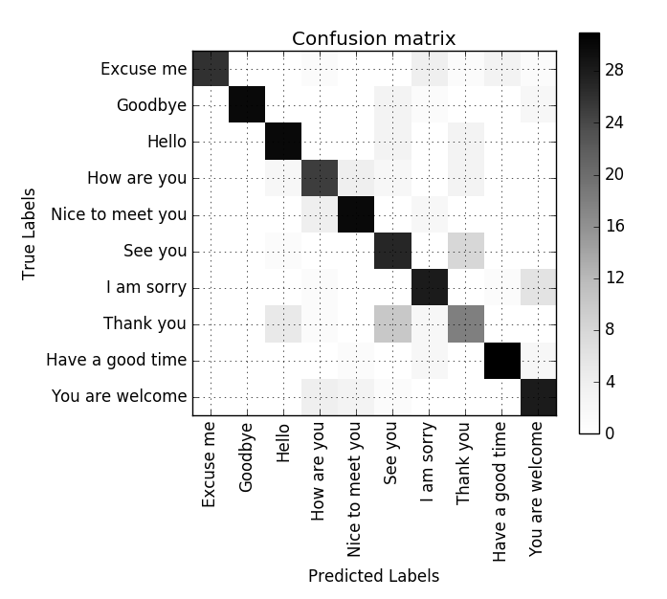
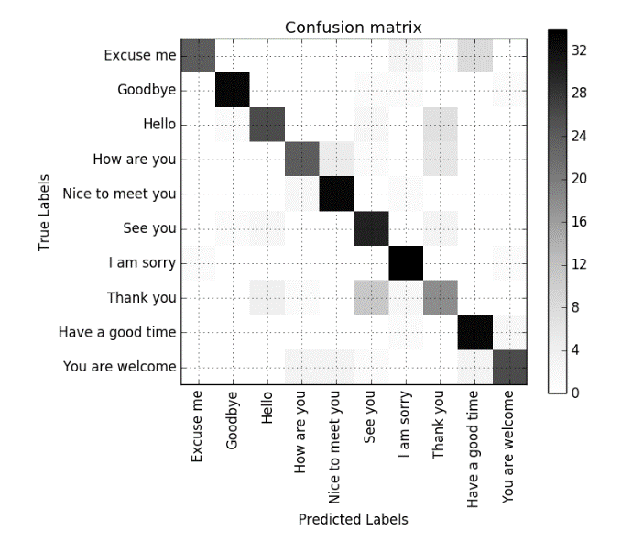
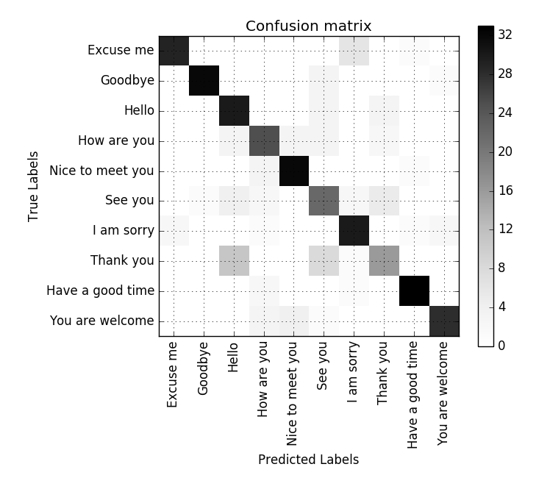
Single view - Model 704

Slide 5
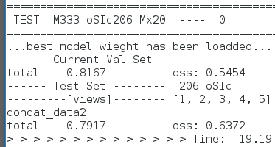
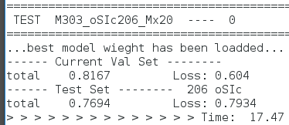
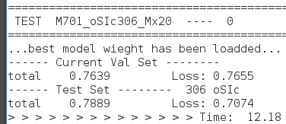
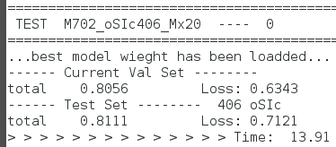
Multi view

Slide 6
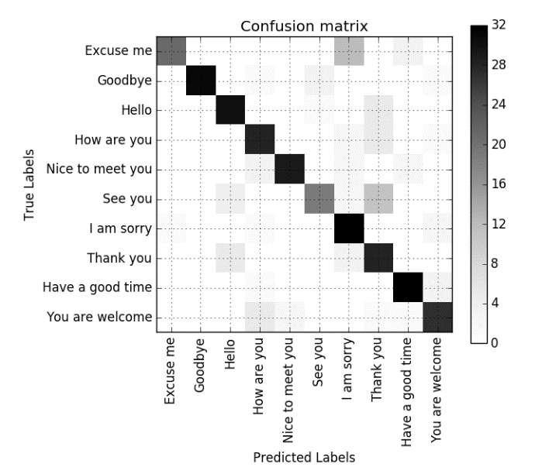
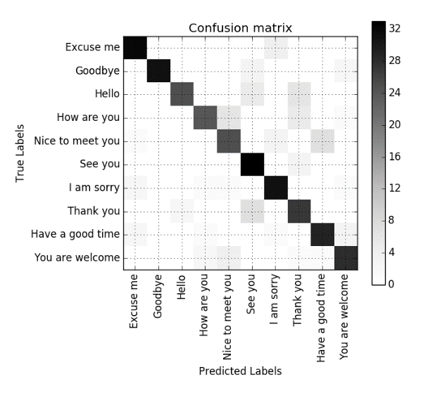
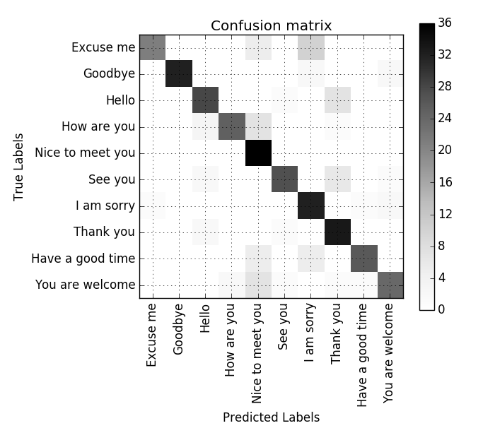
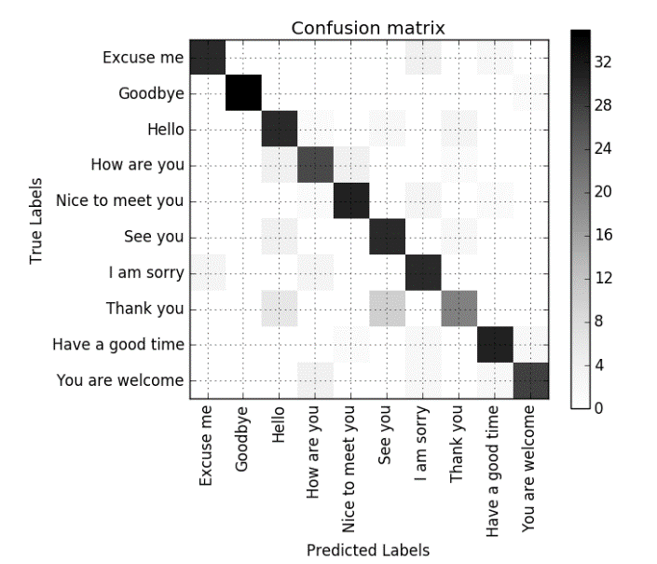
Multi view

Slide 7
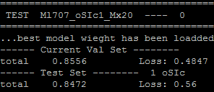
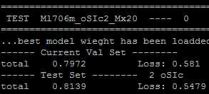
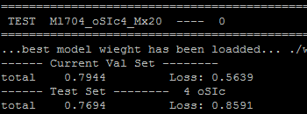
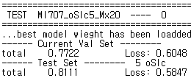
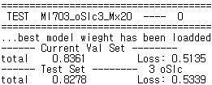
Single view – Batch Normalization with Bi-LSTM

Slide 8
Single view | Frontal | 30 | 45 | 60 | Profile | Average
Original | 81.1% | 80% | 76.9% | 69.2% | 82.2% | 77.9%
BN | 80.56 | 77.78 | 78.61 | 73.89 | 72.78 | 76.72
Bi-LSTM | 80.28 | 75.83 | 83.89% | 75.83% | 82.5% | 80.66%
BN(with bi-lstm) | 84.72 | 81.39 | 82.78 | 76.94 | 81.1 | 81.386
Multi view | 3D-CNN | Merge Channels | Merge Images | Merge Features
 | m333 | i406 | i306 | m303
Original | 76.1% | 78.9% | 80.0% | 79.4%
BN | 82.78 | 84.44 | 81.94 | 82.22
Bi-LSTM | 76.94% | 79.17% | 80.0% | 81.11%
BN+Bi-LSTM | 83.33 | 87.22 | 83.89 | 88.06
Data augmentation | 77.29% | 79.36% | 82.12% | 81.25%
Bi-LSTM + Data augmentation | 78.30% | 79.17% | 80.0% | 81.85%
BN+Bi-LSTM+DAug | 87.78 | 88.89 | 90.00 | 89.17

Slide 9
